Slide 1

Stacks and Queues
Collection Classes Part 2
Chris Piech
CS 106B
Lecture 3
Jan 11, 2015

Slide 2



Slide 3


Slide 4


Computer Forum Career Fair
Computer Forum Career Fair
When:
What:
Date:
Time:
Location:
Description:
Wed, Jan 13th
Computer Forum Career Fair
Wednesday, January 14
Time: 11am - 4pm
Lawn between the Gates CS Building and the Electrical Engineering Buildings
The Computer Forum Career Fairs enable Stanford Engineering students, specifically CS and EE, to get a head start on careers and internships.

Slide 5
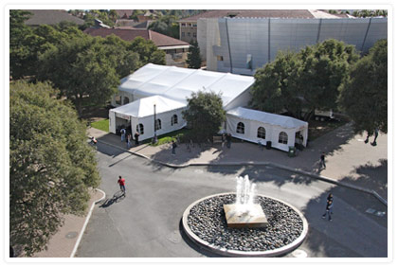
Keep a job for me… Im coming!

Slide 6

CS + Social Good

Slide 7
Collections
Vector
Grid
Map
Stack
Queue
Set

Slide 8
Collections
Vector
Grid
Map
Stack
Queue
Set

Slide 9

Today’s Goals
Learn how to use Stacks
Learn how to use Queues

Slide 10


Today’s Goals
Monday
Music
Queues
Stacks
Review

Slide 11
Today’s Goals
Monday
Music
Queues
Stacks
Review

Slide 12


Slide 13
Collection Classes
These classes contain other objects and are called container or collection classes.
Vector
Grid
Stack
Queue
Map
Set
Here are some general guidelines for using these classes:
These classes represent abstract data types whose details are hidden.
Each class requires type parameters.
Any memory for these objects is freed when its declaration scope ends.
Assigning one value to another copies the entire structure.
To avoid copying, these structures are usually passed by reference.

Slide 14
Template Classes
The collection classes are implemented as template classes, which make it possible for an entire family of classes to share the same code.
Instead of using the class name alone, the collection classes require a type parameter that specifies the element type. For example, Vector<int> represents a vector of integers. Similarly, Grid<char> represents a two-dimensional array of characters.
It is possible to nest classes, so that, for example, you could use the following definition to represent a list of chess positions:
Vector<Grid<char> > chessPositions;

Slide 15
Review: Read File to Vector
/*
* Function: readEntireFile
* Usage: readEntireFile(is, lines);
* ---------------------------------
* Reads the entire contents of the specified input stream
* into the string vector lines. The client is responsible
* for opening and closing the stream
*/
void readEntireFile(istream & is, Vector<string> & lines) {
lines.clear();
string line;
while (getline(is, line)) {
lines.add(line);
}
}

Slide 16
Review: Read File to Vector
/*
* Function: readEntireFile
* Usage: readEntireFile(is, lines);
* ---------------------------------
* Reads the entire contents of the specified input stream
* into the string vector lines. The client is responsible
* for opening and closing the stream
*/
void readEntireFile(istream & is, Vector<string> & lines) {
lines.clear();
string line;
while (getline(is, line)) {
lines.add(line);
}
}

Slide 17
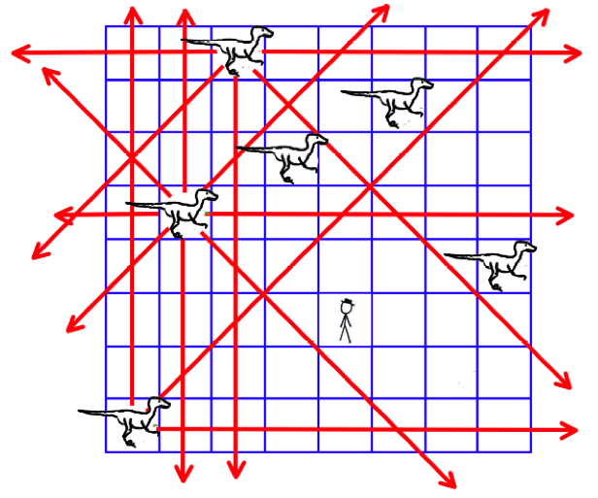
Velociraptor Safety
board[x][y] crashed our program when x was -1

Slide 18
Today’s Goals
Monday
Music
Queues
Stacks
Review

Slide 19
Today’s Goals
Monday
Music
Queues
Stacks
Review

Slide 20



The Stack Metaphor
Last in, first out. LIFO
push and pop
Dish metaphor

Slide 21
The Stack<type>
stack.size()
Returns the number of values pushed onto the stack.
stack.isEmpty()
Returns true if the stack is empty.
stack.push(value)
Pushes a new value onto the stack.
stack.pop()
Removes and returns the top value from the stack.
stack.peek()
Returns the top value from the stack without removing it.
stack.clear()
Removes all values from the stack.

Slide 22
The Stack<type>
stack.isEmpty()
Returns true if the stack is empty.
stack.push(value)
Pushes a new value onto the stack.
stack.pop()
Removes and returns the top value from the stack.

Slide 23
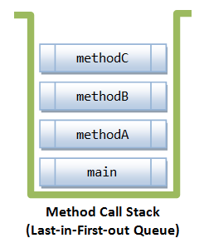
The Call Stack
functionC
functionB
functionA
main
Function (aka method) call stack:
Last in, First out Queue

Slide 24

Balance Parenthesis
Check if parenthesis are balanced
{ s = 2 * (3); x = (1 + (2)); }
OperatorMatching
{ s = 2 * (3); x = (1 + (2)); }
Enter string:
Brackets are properly nested
Enter string:
(a(2) + b(3}
Brackets are incorrect
Enter string:

Slide 25
Today’s Goals
Monday
Music
Queues
Stacks
Review

Slide 26
Today’s Goals
Monday
Music
Queues
Stacks
Review

Slide 27
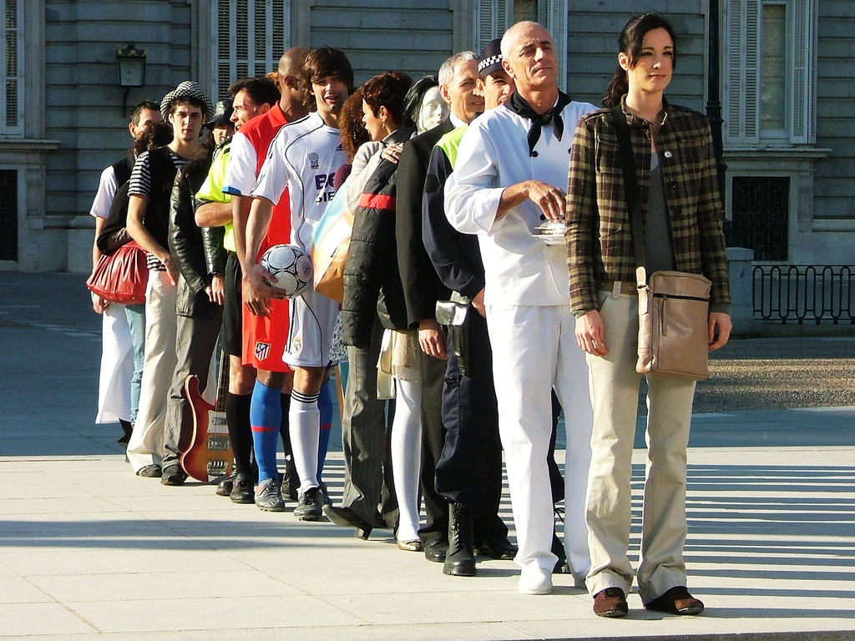
The Queue Metaphor
First in, first out. FIFO
enqueue and dequeue
Line metaphor

Slide 28
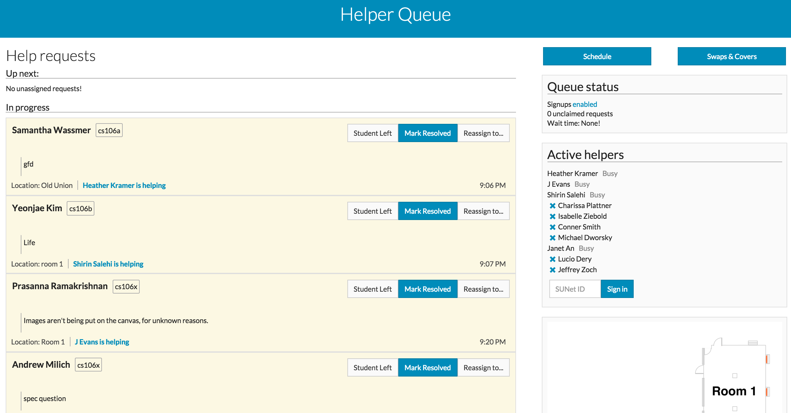
The LaIR Queue

Slide 29
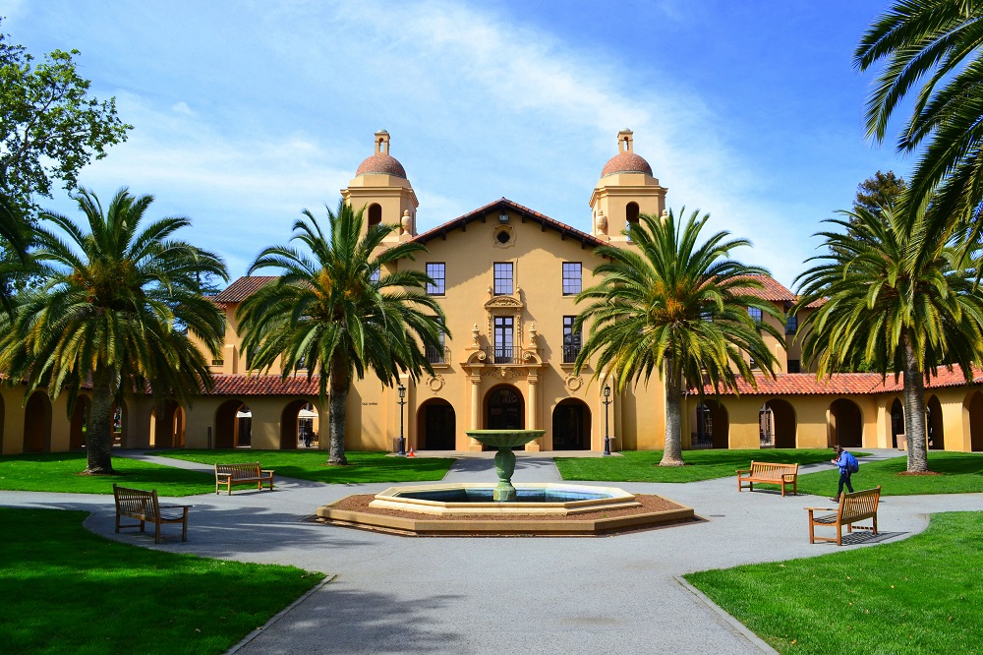

The LaIR Queue
Hermoine Granger: I don’t understand file reading on Game of Life

Slide 30
The LaIR Queue
Hermoine Granger

Slide 31

The LaIR Queue
Ron Weasley: My QT Creator is doing something weird

Slide 32
The LaIR Queue
Hermoine Granger
Ron Weasley

Slide 33
The LaIR Queue
Hermoine Granger: I get it! Thanks for the help…

Slide 34
The LaIR Queue
Ron Weasley

Slide 35
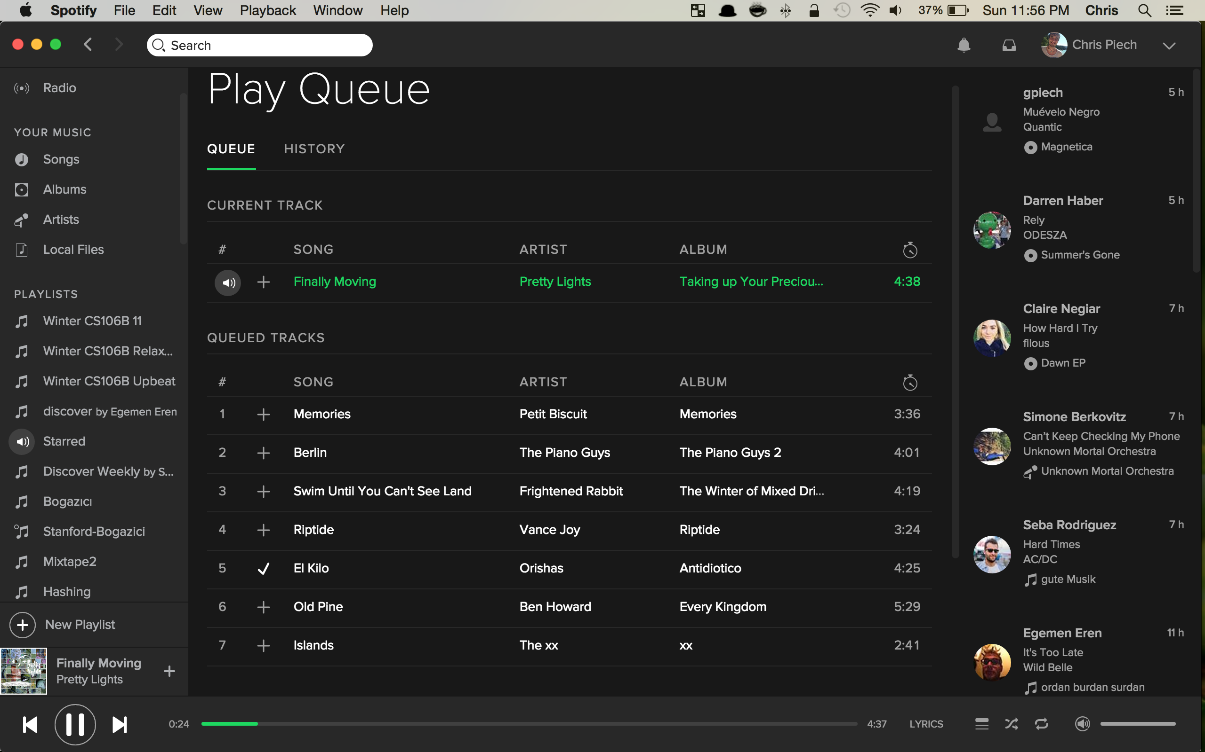


Slide 36
Queue<type>
queue.size()
Returns the number of values in the queue.
queue.isEmpty()
Returns true if the queue is empty.
queue.enqueue(value)
Adds a new value to the end of the queue (which is often called its tail).
queue.dequeue()
Removes and returns the value at the front of the queue (its head).
queue.peek()
Returns the value at the head of the queue without removing it.
queue.clear()
Removes all values from the queue.

Slide 37
Queue<type>
queue.isEmpty()
Returns true if the queue is empty.
queue.enqueue(value)
Adds a new value to the end of the queue (which is often called its tail).
queue.dequeue()
Removes and returns the value at the front of the queue (its head).

Slide 38

Stacks vs Queues

Slide 39
Stacks vs Queues
N
A
D
push
Stack:
pop
N
D
A
enqueue
Queue:
dequeue

Slide 40
Why not Vector?

Slide 41
Today’s Goals
Monday
Music
Queues
Stacks
Review

Slide 42
Today’s Goals
Monday
Music
Queues
Stacks
Review

Slide 44
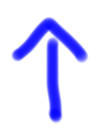
Digital Music: Queue of Intensities
song:
…
0.01
0.16
0.31
0.45
0.58
0.69
Front of the queue
0.67

Slide 45
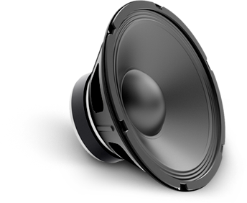
Playing Digital Music
1. Dequeue
2. Play
song:
…
0.01
0.16
0.31
0.45
0.58
0.69
Front of the queue

Slide 46
Playing Digital Music
1. Dequeue
2. Play
song:
…
0.01
0.16
0.31
0.45
0.58
0.69
Front of the queue

Slide 47
Playing Digital Music
1. Dequeue
2. Play
song:
…
0.01
0.16
0.31
0.45
0.58
0.69
Front of the queue

Slide 48
Playing Digital Music
1. Dequeue
2. Play
song:
…
0.16
0.31
0.45
0.58
0.69
0.78
Front of the queue

Slide 49
Digital Music
song:
0.01
0.16
0.31
0.45
0.58
0.69
The Sun
by
Parov Stelar
0.78
0.85
0.90
0.93
0.95
0.95
0.93
0.02 milliseconds of music
…
0.91
0.88
0.84
0.81
0.77
0.74
0.71
0.67

Slide 50
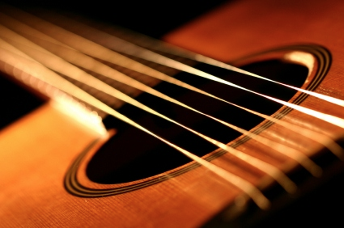

Slide 51
Guitar String
void pluck(Queue<double>& sound, double freq) {
}
double sample(Queue<double>& sound) {
}
0.67

Slide 52
How to pluck a guitar string

Slide 53

Karplus Algorithm: Pluck
Each string has a frequency.
Let N be the number of speaker samples in one wave at that frequency.
Enqueue N random numbers.
0.67

Slide 54
How to sample a guitar string

Slide 55
Karplus Algorithm: Sample
…
0.01
0.16
0.31
0.45
0.58
Front of the queue

Slide 56
Karplus Algorithm: Sample
1. Average these two numbers and enqueue the result * 0.997
…
0.01
0.16
0.31
0.45
0.58
Front of the queue

Slide 57
Karplus Algorithm: Sample
Enqueue
1. Average these two numbers and enqueue the result * 0.997
0.08
…
0.01
0.16
0.31
0.45
0.58
Front of the queue

Slide 58
Karplus Algorithm: Sample
2. Dequeue the top for the speaker to play
…
0.01
0.16
0.31
0.45
0.58
Front of the queue

Slide 59
Karplus Algorithm: Sample
2. Dequeue the top for the speaker to play
…
0.16
0.31
0.45
0.58
0.12
0.01
Front of the queue

Slide 60
Guitar String
void pluck(Queue<double>& sound, double freq) {
sound.clear();
int n = RATE / freq; //how many values we need
for(int i = 0; i < n; i++) {
sound.queue(randomReal(-1.0, 1.0));
}
}
double sample(Queue<double>& sound) {
double a = sound.dequeue();
double b = sound.peek();
double next = 0.997 * (a + b) / 2;
sound.enqueue(next);
return a;
}
0.67

Slide 61
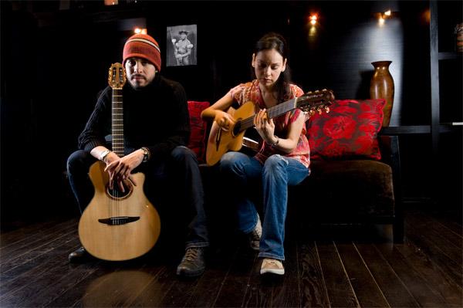
Guitar Strings are an open problem.
Accidents lead to new sounds.

Slide 62
Today’s Goals
Monday
Music
Queues
Stacks
Review

Slide 63
Today’s Goals
Monday
Music
Queues
Stacks
Review

Slide 64
Today’s Goals
Learn how to use Stacks
Learn how to use Queues

Slide 65
The End

